Slide 1
Improving Digital Accessibility
A year-long strategic approach to improve the accessibility of EPA/ORD’s digital products
Digital Accessibility Working Group (DAWG)
Jessica Dearie, Joanne Mosuela, Jacques Kapuscinski, & Arlo Liu
Notes:
JESS
The EPA’s Office of Research and Development embarked on a yearlong strategy to improve the accessibility of its digital products in CY2023.

Slide 2
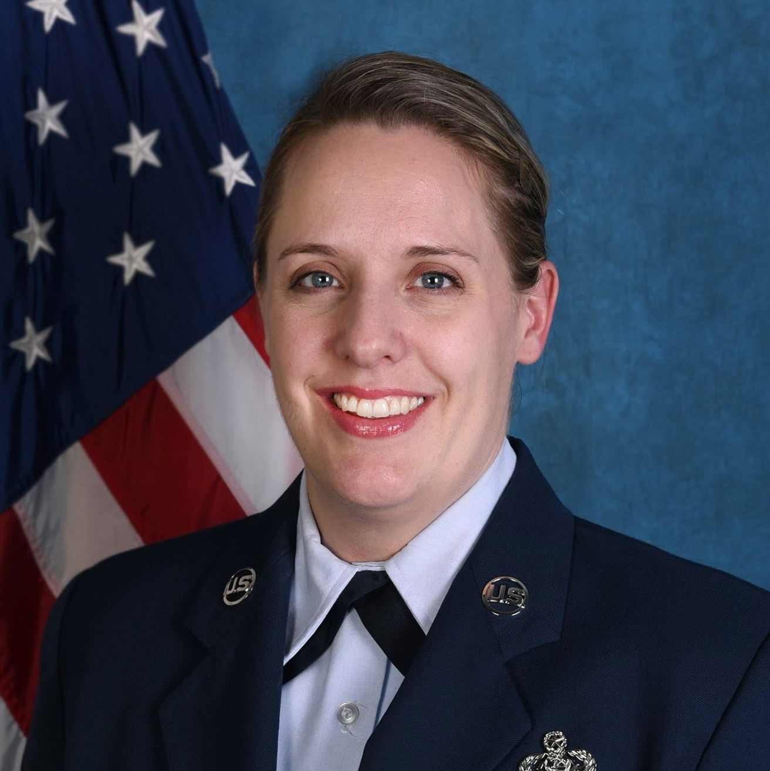
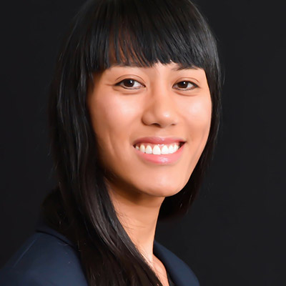


Meet the DAWG - Introductions
Jessica Dearie
Joanne Mosuela
Jacques Kapuscinski
Arlo Liu
Notes:
Introduce ourselves and say what we work on primarily – Jess to introduce Arlo

Slide 3
About the DAWG
Minimal, if any, formal responsibility for Section 508
ORD’s Section 508 program
Coordinated with agency Section 508
Notes:
JESS
ORD is the largest organization in the EPA and has over 6k pages of public content (3rd largest of the agency)
Several of us in OSIM work with ORD employees in the area of digital accessibility.
While our office manages Section 508 within ORD, there’s not a formal program for anything other than waivers and some purchasing
Before starting anything, we met with the agency Section 508 office to make sure we would align with whatever they might have planned.

Slide 4
Start with Why
DEIA
Help
1:1
DAWG
Notes:
JESS
With the passing of the Executive Order that added A to DEI, there was an increased focus on accessibility and on requiring compliance
EPA has always been a supporter of DEI programs, but now the A was added on. You can’t talk about DEI without adding A.
ORD employees and seeking out information on requirements and asking for guidance.
As many of us started having 1:1 calls and meetings, we realized this wasn’t sustainable
A few OSIM employees came together in what we call the DAWG and developed a year-long strategy help ORD improve its digital accessibility.
After meeting with the agency Section 508 program office we aligned our goals, but ultimately decided to take a more aggressive hands-on approach.

Slide 5
The Plan
Educate ORD employees on the importance of accessibility.
Improve the accessibility of the digital products ORD produces.
Notes:
JESS
Met with leadership groups at all levels – from first line supervisors to senior leadership
Shared the plan to educate + improve the accessibility of ORDs digital products
Got buy in to prioritize this work – time & resources (contractor dollars sometimes)

Slide 6
Four Critical Focus Areas
Understanding
Web Pages
PDFS
Applications
Notes:
JESS
Educate ORD employees on the impact of accessibility and consequences of non-conformance.
How real people are impacted
Legal requirements to be compliant
Exceptions don’t mean you don’t have to provide the same information in an alternative way
Fix the top accessibility issues in web pages.
Fix the top accessibility issues in PDFs.
Increase the total number of applications being tested

Slide 7
Meeting the Goal
Survey
Webinars
Training
Weekly Compass
Existing Resources
Challenges
Notes:
JESS
We issued quarterly surveys to gauge overall knowledge of Digital Accessibility and identify gaps that need filling
Quarterly webinars on general knowledge and overview
Real world examples of how people engage with digital content using assistive technology
How they are impacted when something isn’t accessible
What it means to be accessible (POUR, WCAG 2.x, etc)
Weekly training that tie directly into the issues we are looking to fix
while built for ORD, opened to the agency and always had non-ORD staff on
Use the weekly compass (ORD’s weekly digital newsletter) to provide tips, tricks, bits of knowledge
Hosted Several Challenges: GAAD, Section 508 anniversary challenge, Plain Language
Brought visibility to non-ORD resources: the agency Digital Accessibility team for collaboration, OMS MS Office training, checklists, etc
Quarterly analysis of our metrics to track improvement (survey answers, # of issues/occurrences, # of compliant applications etc)
- Use the metrics to adjust focus areas as needed.

Slide 8




Tools We Used
Drupal Webforms
Site improve
Editoria11y
Trusted Tester Methodology
Notes:
JOANNE
Drupal (webform) – to build our surveys and collect responses
Site improve – public web stats, dashboards
Editoria11y – drupal module intranet and public web stats and provides immediate editor feedback on things content editors can fix
Trusted Tester Methodology – which includes the use of ANDI (both as part of formal trusted tester testing and just as a tool to check individual things)

Slide 9
Web Page Issues we Tracked
Pages with Issues
Occurrences of Seven Specific Issues
Link missing a text alternative
Empty Headings
No data cells assigned to table header
Table headers aren’t referenced correctly
Form field is not labeled
Visible label and accessible label do not match
Image without alt text
January 2023
289
Pages with Issues
5351
Occurances of Issues
Notes:
JESS
Data as of Jan 5, 2023 – public web focused; no reporting tool for intranet
We focused on the total number of pages with one of 7 specific issues – and the number of occurrences of those issues
Metrics were all over the place with only 2 occurrences on 1 page of missing alt text to over 4700 table headers not referenced correctly on over 40 pages
We’ll share the specific numbers when we talk about our results.

Slide 10
PDF Issues we Tracked
PDFs with Issues
Non Machine Readable
Not Tagged
Other Issues
115
Not Machine Readable
3292
Total PDFs with Issues
522
Not Tagged
7304
Other Issues
Notes:
JESS
Siteimprove does not report information about PDFs in the same way as web pages.
We tracked the number of PDFs with issues and broke out the numbers for machine readability, tagging, and what Siteimprove lumped into “Other”
Other Issues (sample)​
The document has no title​
The document is missing a language definition​
The document has no bookmarks​
The image has no alternative presentation​
The heading structure is incorrect
Over 100 not machine readable. Over 500 not tagged, but over 7000 other issues

Slide 11
Results
Increased understanding
Reduction of issues on web pages
PDFS will always be a problem
Increased total apps being tested
Notes:
JESS
Holding weekly training webinars, publishing weekly e-newsletter articles, holding multiple challenges, and educating employees on what it means to create accessible content, we started to see results
Increased understanding
Reductions of issues across the board
Some PDF issues were resolved, but the abundance of PDFs continues to be a problem.
Let’s look at the data

Slide 12
Understanding Practices & Standards
How familiar are you with Section 508 digital accessibility practices and standards?
Notes:
JOANNE
Understanding was measured through the survey responses. The math isn’t perfect – we couldn’t always reach the same people each time. We hoped to see trends of greater understanding – and we did.
Familiarity with standards increased over time.
286 submissions in total
142 submissions in the first
132 submissions in the second (only 37% took the first)
12 submissions in the third (only

Slide 13
Understanding Consequences of Non-Compliance
On a scale of 0-5 (with 0 being not at all and 5 being fully understand), how well do you understand digital accessibility and the consequences of not complying?
Notes:
JOANNE
Understanding the consequences of non-compliance increased over time.

Slide 14
Understanding Accessibility Tools
Are you aware that there are accessibility tools you can use when creating content?
Notes:
JOANN
Of those surveyed, we reached full awareness of accessibility tools.

Slide 15
Web Page Issues Results
Jan 2023
Mar 2023
Sep 2023
Nov 2023
4%
4%
3%
2%
289
Pages with Issues
of
6654
269
Pages with Issues
of
6494
218
Pages with Issues
of
6569
144
Pages with Issues
of
6989
5351
Occurances of Issues
4995
Occurances of Issues
5140
Occurances of Issues
4925
Occurances of Issues
Notes:
JESS
Reduced number of pages with issues by 145 pages
Remediated over 426 issues (technically we remediated more because we had to fix issues we newly created)

Slide 16
Web Page Issue Occurrences Results
Issue | Jan 2023 | Mar 2023 | Sep 2023 | Nov 2023 | % Reduced
Link missing a text alternative | 167 | 166 | 69 | 24 | 86%
Empty Headings | 155 | 144 | 89 | 7 | 95%
No data cells assigned to table header | 222 | 196 | 207 | 206 | 7%
Table headers aren't referenced correctly | 4712 | 4418 | 4702 | 4627 | 2%
Form field is not labeled | 69 | 53 | 53 | 43 | 38%
Visible label and accessible label do not match | 20 | 18 | 20 | 18 | 10%
Image without alt text | 2 | 0 | 0 | 0 | 100%
Total Occurrences | 5347 | 4995 | 5140 | 4925 | 8%
Notes:
JESS

Slide 17



PDF Issues in ORD Web Areas (www)
Jan 2023
Mar 2023
Sep 2023
Nov 2023
3292
Total PDFs with Issues
3175
Total PDFs with Issues
3203
Total PDFs with Issues
3756
Total PDFs with Issue
115
Not Machine Readable
101
Not Machine Readable
103
Not Machine Readable
103
Not Machine Readable
552
Not Tagged
500
Not Tagged
511
Not Tagged
595
Not Tagged
7304
Other Issues
7041
Other Issues
7092
Other Issues
8139
Other Issues
Notes:
JESSICA
In Jan we had around 6000 PDFs. The reports aren’t sophisticated enough to break down
By March
We were able to reduce the total number of PDFs with issues by over 100
Reduced the number of PDFs that were not machine readable and not tagged
(Note – this does not mean the files are tagged correctly – that’s a separate monster)
Remediated nearly 300 other issues (no title, incorrect structure, and more)
Unfortunately, in September the trend started to decline and by Nov we were worse than where we started.
PDFs are complicated – not easy to remediate and take longer to fix and upload

Slide 18
Applications
January 2023
November 2023
143
Total Internal Systems
134
Total Internal Systems
136
Not Tested
4
Not Compliant
120
Not Tested
8
Not Compliant
2
Compliant
1
Exempt
3
Compliant
3
Exempt
Notes:
JOANNE
Our goal was to reduce the number of applications not tested
We expected the number of non-compliant apps to go up as more were tested.
We were able to sunset several applications and exempt a few more – that reduced our overall number of systems to be tested.
One additional application was made compliant and a few not – but the overall goal of reducing the number of applications not tested was met.

Slide 19
Testimonials
I'm personally impacted with a lot of guilt knowing the total number of issues on our sites.
The training is the message they all [our scientists] need to get.
We make people provide us 508 compliant PDFs or we won’t post them [on our site].
Notes:
JACQUES

Slide 20
Lessons Learned
Weekly training – improved skills and visibility
Challenges Focused Efforts
some cases resolved all occurrences
PDFs will always be an issue
Additional Training for Source tools
Word, PowerPoint, etc
Data is tricky
No static data to move down from
Notes:
JESS
Opened up to all offices – agency impact with ORD plan

Slide 21
What’s Next?
Continued reporting of metrics
Training as needed
Adoption of our training by:
Agency Section 508 office
Other program offices/regions

Slide 22
Summary / Conclusion
People want to create accessible content
Our Year-Long Strategic Approach:
Improved understanding
Reduction in issues
Hiring/Increasing Certified Trusted Testers
More thinking accessibility first
Notes:
JESS
The interest and the commitment is there: most people just lacked the knowledge, tools, and resources
Trusted testers - more
Without our efforts, not only would we not see reductions; we would expect an increase
The focused effort is making a culture change and we are seeing people looking to create accessible products first.

Slide 23
Questions?

